Slide 1
2019 Annual Giving Campaign Kick-Off

Slide 2
Welcome
Why are we here?
Annual Giving Campaign Timeline
Kick-Off Celebration, Today
Bishop’s Visit, September 29th
Annual Giving Focus during Worship in October
Ingathering Sunday & Ministry Fair, All Saints’ Sunday, November 3rd
Notes:
Trying something new this year. Traditionally the Festive Meal wrapped up the Stewardship Campaign, this year we’re starting with the party.
Timeline: Starting with the party, giving thanks for our blessings, ending with the Ministry Fair and the invitation to commit Time, Talent & Treasure on the same Sunday.
Throw to Fr. Patrick to talk about the development of the 2020 Vision and invitation to generosity.

Slide 3
2020 Vision An Invitation to Love God and Love Neighbor

Slide 4
Survey history/stats
Vestry hired Holy Cow! Consulting to use their Congregational Assessment Tool to help us learn more about St. Paul’s
In Lent 2019, 119 active members were invited to take the survey.
69 people responded
The Vestry had the survey data “read” at a meeting on April 16
Survey data was incorporated into discussion at a retreat on April 27

Slide 5
Survey Data: Congregational Priorities
Notes:
There’s really too much to cover, so sharing salient aggregate detail and what especially stood out to the vestry.
Overall, the top three priorities of the congregation are…
#1 appears in the top 3 of 92% of those surveyed

Slide 6
Survey Data: Age Focus
When disaggregated by age group, the data gets interesting
Notes:
So if there’s a focus on a desire to draw young folks and young families, let’s think about what they need?
While age groups tend to share similar weight to most priorities, younger folks stand out in a few areas.
Young folks want relationships, attempts to reach new people and outreach

Slide 7
Survey Data: Drivers of Satisfaction
Notes:
We are in 15% of congregations called “Power-Focused” congregations. High degree of interest and focus on Clergy and Lay Leadership. Main way to move to higher satisfaction is to put focus on Mission.

Slide 8
Survey Data: Drivers of Energy

Slide 9
The Energy-Satisfaction Map
Notes:
Low Satisfaction, High Energy means we are in the ”Chaos Quadrant” (barely) (Want to move to the High-High “Transformational” quadrant.)

Slide 10
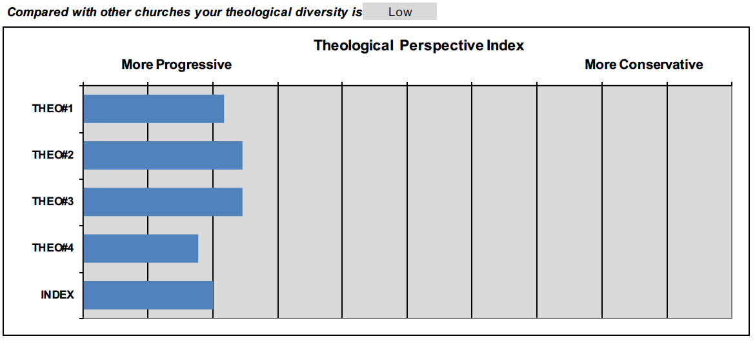
St. Paul’s Theology

Slide 11
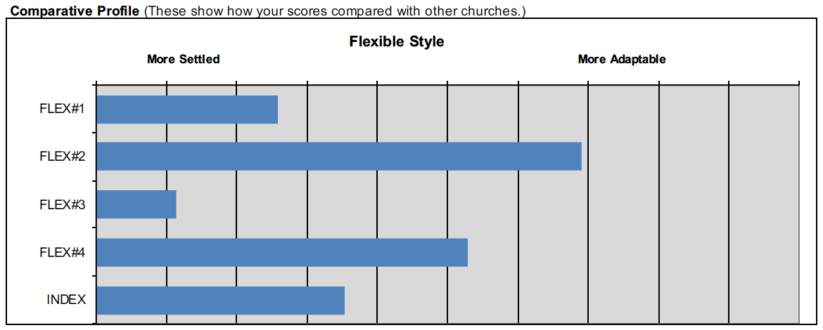
St. Paul’s Flexibility
Notes:
Together, these are drivers make up the Operating System, or Organizational Culture.
STAR QUESTION #3. Less willingness to adapt worship.

Slide 12
St. Paul’s Operating System (Organizational Culture)
Notes:
Determined through discernment of questions relating to type of theology a church generally ascribes to and level of flexibility within the congregation.
Whereas there are value judgements assumed with the first quadrant (There’s a good quadrant to be in…) Here this is just a description and there are positives and negatives.

Slide 13
St. Paul’s Operating System (Progressive-Settled)
At its Best
At Its Worst
Intellectually open, but pays attention to structure & ritual
Respect for diversity
Honors and respects hand-to-hand ministry
Encourages members to ministry
Loss of missional focus leads to routines
Can get stuck in historic modes of ministry
Burnout as ministers try to keep aging ministries going
Accepting everybody means a loss in accountability

Slide 14
Performance
High Scores
Conflict Management
Moderate Scores
Morale
Governance
Readiness for Ministry
Low Scores
Hospitality
Spiritual Vitality
Engagement in Education
Worship and Music
Notes:
These are self-assessed. How the church sees itself falling into these areas.
Briefly look at two of our most interesting low scores.

Slide 15
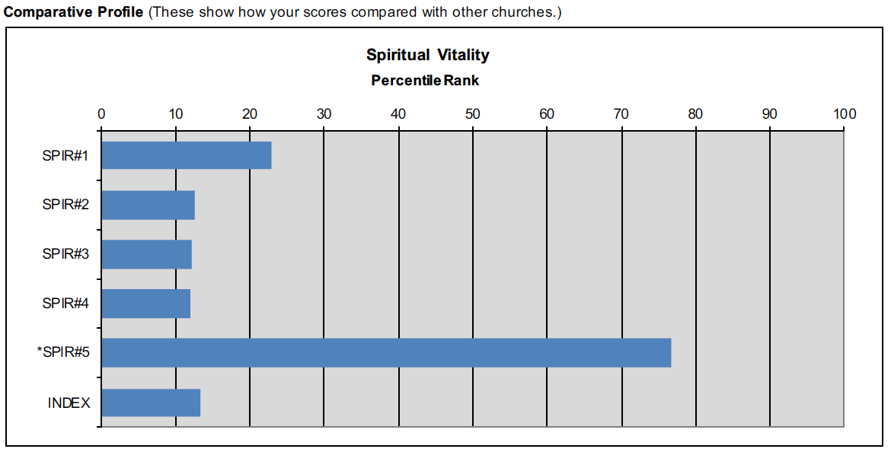
Spiritual Vitality Index
Notes:
“Measures the degree to which members believe that their faith is central to their lives rather than peripheral or episodic.
Mild correlation to Hospitality Index. Strong correlation to the percent of household income that members give to the church.”
These are indexed responses, so while few actively disagreed with any of these things, the level of agreement was low.

Slide 16
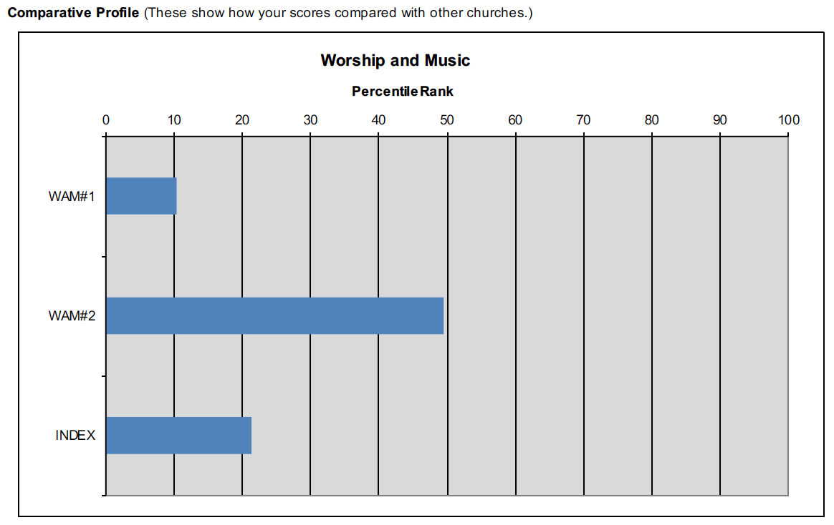
Worship and Music Index
Notes:
“Captures the congregation’s feelings about the quality of the worship experience.”
Remember on our flexibility index: About willingness to adapt worship.

Slide 17
Summary of Survey Standouts
Low Spiritual Vitality
Low Regard for Music, but Low Flexibility in changing worship
Focus and Priority on Education & Welcoming Young Families
Who desire effective outreach, education, and connection
An Operating System that honors established ministry, but struggles with leadership burnout

Slide 18
Missional Learning in the Vestry
Vestry Retreat Texts
Survey & Roxburgh Book
Continued to Read and Discuss as the year went forward
2020 Vision starts to coalesce as we bring the survey and Roxburgh into conversation
Notes:
2015 book

Slide 19
The Missional Church “Thesis”: The Problem
Membership decline in Mainline Protestant Churches is a sociological force that has been happening since World War II.
There is no magic pill that stops this.
The anxiety this decline produces leads the faithful to profoundly wrong (but usually implicit) theological beliefs about who and where God is.
God is mine.
God is exclusively in church.
Christ wants us to take care of each other before others.
These heterodox beliefs about God’s nature and location lead to expressions of faith (practices) that are attractional, isolationist, and, in the extreme, antagonistic to the neighborhood and neighbors.
Notes:
Too much to cover, but salient points
Heterodox is my nice way of saying heretical

Slide 20
The Missional Church “Thesis”: The Solution
Decline reveals a spiritual sickness, not a programmatic one.
Churches are less connected to God, less connected to each other, and extremely less connected to neighborhood.
Recovery from this sickness requires spiritual depth AND depth of service.
Developed through regular, recurring practices.
(Which, incidentally, is basically what Jesus was talking about the whole time.)
Agape

Slide 21
Out Reach
In Reach
Service
Spirituality
Love Neighbor
Love God
Notes:
So I’ve been explaining it thusly.

Slide 22
How have we initially responded?
The Way of Love: Practice-focused invitation from the Presiding Bishop and our Bishop. Turn, Learn, Pray, Worship, Bless, Go, Rest
Children’s Chapel: Children-focused time for spiritual reflection and formation during the 10:45am service.
Missional-Church Focused Sermons
Return of School Year Kick-Off Ice Cream Social & Blessing of Backpacks
Ministry Fair, November 3: Invitation to get involved

Slide 23
What’s Next?
Grow Spiritual and Service Depth through invitation to practices.
Three Foci
Love God: Worship
Love Neighbor: Outreach
Love God & Neighbor: Inreach

Slide 24
Love God: Worship
Worship is the cornerstone of a parish community. It is THE thing that we all do together.
Puzzle: Low satisfaction in music coupled with low flexibility in worship change with a sprinkling of too few people in the choir.
Cheapest/Easiest Solution: More people step up to join the choir.
Solution for 2020: Choral Scholar Program
One paid student section leader per section (SAB)
Cost: $3,150
$1,000 from diocesan matching grant for parish-based campus ministry

Slide 25
Love Neighbor: Missional Outreach
Service is at the core of Christian self-definition. Outreach is important to our identity as St. Paul’s.
Puzzle: We love our extant outreach ministries (attractional in nature), but we have incredibly low participation.
Query: Is it possible that our allegiance to extant ministry narrows our mindset of what outreach could be? Are we afraid of experimenting something new because we don’t want to be disloyal?
Cheapest/Easiest Solution: More people step up and participate in current ministries.
Solution for 2020: Missional Microgrants
Opportunities for parishioners to leverage the Lay Discernment Committee and the resources of the parish to experiment in mission.
Cost: $3,000 seed-fund
Notes:
“Saying: St. Paul’s wants you to be creative about mission. If this isn’t your mission, what is?”

Slide 26
Love God & Neighbor: Inreach
The more we get to know each other in the context of holy fellowship & spiritual practice, the more we know God, the more we are able to focus our efforts outward.
Puzzle: We desire to “make necessary changes to attract young families.” Young families desire opportunities to build relationship and spirituality.
Cheapest/Easiest Solution: We start to invite new people (of many different ages) into our relationship groups.
Solution for 2020: Inreach Microgrants
Money set aside for parishioners to brainstorm and execute spiritual and fellowship-focused events open to the congregation.
Cost: $3,000 seed-fund
Notes:
This stuff doesn’t happen if it’s up to Fr. Patrick to make it happen.

Slide 27
Love Neighbor
Love God
Change the World
A 2020 Vision for St. Paul’s Episcopal Church
Manhattan, Kansas

Slide 28
Consider your 2020 Annual Gift to St. Paul’s
Generosity to the Budget is Generosity to its Mission
Notes:
All of this happens because we recognize the way the budget supports the mission of the church
This year, the auditor helped us calculate how much of our budget is used for mission/program and how much for administration. I was shocked to learn that, according to GAAP, we’re at 79% Program, 21% Administration. The mission of St. Paul’s happens because we support the budget.
In other words, the budget blesses you and blesses the world.
::Throw to David::

Slide 29
2019 Annual Giving Campaign
Notes:
From Vestry Letter: “God first called Abram by saying, “Go from your country and your kindred and your father’s house to the land that I will show you.” God made Abram a promise: “I will make of you a great nation, and I will bless you, and make your name great, so that you will be a blessing…and in you all the families of the earth shall be blessed.” (Genesis 12:1-3) In Abram’s footsteps, we have been bestowed with great blessings: as individuals and as a congregation. This year, the vestry asks: Where is God calling us to move forward? And how can we join God and Abram in being a blessing?”
How do we support this compelling vision of a more connected and connecting parish?

Slide 30
Two Ways to Respond
Help us visualize the impact of St. Paul’s in the community using the map & pins
Complete your pledge card
Notes:
David’s Slide

Slide 31
Thank You!

