Slide 1
Incarnating Christian Community Through Productive Disagreement
Advent 2019 Adult Ed
St. Paul’s Episcopal Church
Manhattan, KS
Fr. Patrick Funston

Slide 2
Why Discuss Disagreement?
Christian formation is formation for life
Life is lived with others
Where humans interact, disagreement is natural and expected
However, the average person dreads argument and disagreement
Impeachment
Election 2020
Political, Economic and Social Change
Ongoing parish conversations around Race, Mission & Outreach
Notes:
We have a lot of opportunity to practice productive disagreement

Slide 3
What Does This Have to do with Advent?
“I appeal to you therefore, brothers and sisters, by the mercies of God, to present your bodies as a living sacrifice, holy and acceptable to God, which is your spiritual worship. Do not be conformed to this world, but be transformed by the renewing of your minds, so that you may discern what is the will of God—what is good and acceptable and perfect. For by the grace given to me I say to everyone among you not to think of yourself more highly than you ought to think, but to think with sober judgement, each according to the measure of faith that God has assigned. For as in one body we have many members, and not all the members have the same function, so we, who are many, are one body in Christ, and individually we are members one of another.”
The anticipation of Advent is the anticipation of the Incarnation, its past, its future, and its present.
Notes:
Romans 12
Incarnation Past: Anticipation of the remembrance of the first Christmas
Incarnation Future: Anticipation of the Parousia, the second coming, Christ’s second Advent
Incarnation Present: We are the body of Christ (Romans, Ephesians, Colossians, etc.)
How do we incarnate Christ as a community? (Through service, worship, etc. But also through modeling a complete body.)

Slide 4
If it is possible, so far as it depends on you, live peaceably with all.
Romans 12.18
Notes:
What is it to live peaceably?
Is peace the absence of conflict? Or is it that inevitable disagreement is tempered and focused into productivity?

Slide 5
Our Resources
St. Paul
Buster Benson
Notes:
St. Paul: Pompeo Girolamo Batoni (1707-1787)
Heard Buster Benson on the “Next Big Idea” podcast talking about productive disagreement.
Okay, let’s get into it.

Slide 6
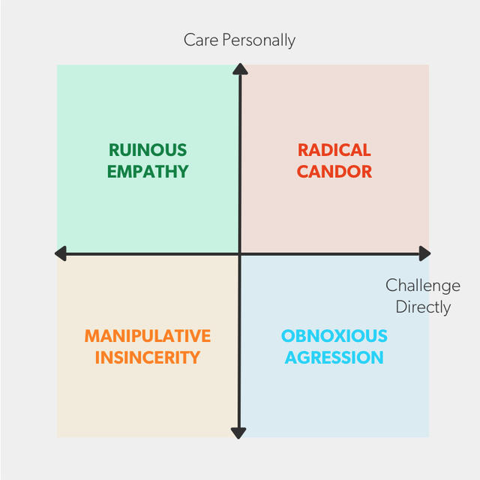
Misconception #1
Arguments are bad
Most people classify arguments as unproductive.
Arguments perform a crucial – and underappreciated – job: they wave the flag that something important to us is being endangered.
Endangerment stirs strong emotions.
Most of us were never taught how to argue.
Hidden disagreements are much worse than surfaced disagreements.
Notes:
Ruinous empathy

Slide 7
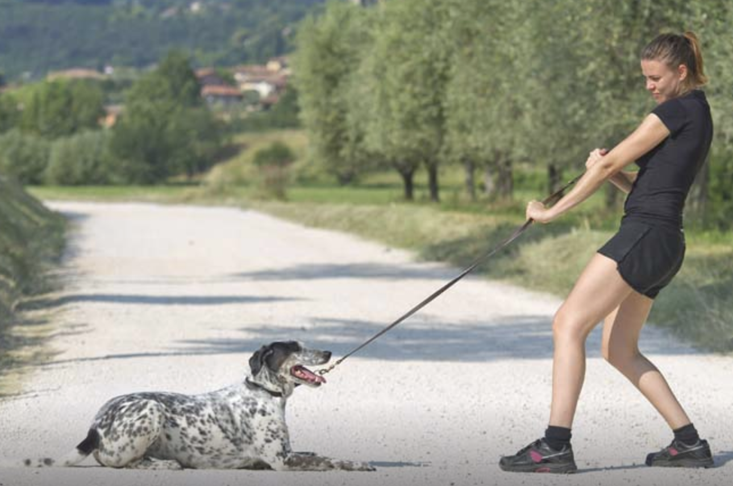
Misconception #2
Arguments change minds
Disagreement: An unacceptable difference between two perspectives.
Once the clash between perspectives becomes unacceptable, our motivation shifts from understanding minds to changing them.
Backfire effect
We can really only change two things: our own minds and our own behavior.
Notes:
Ruinous empathy

Slide 8
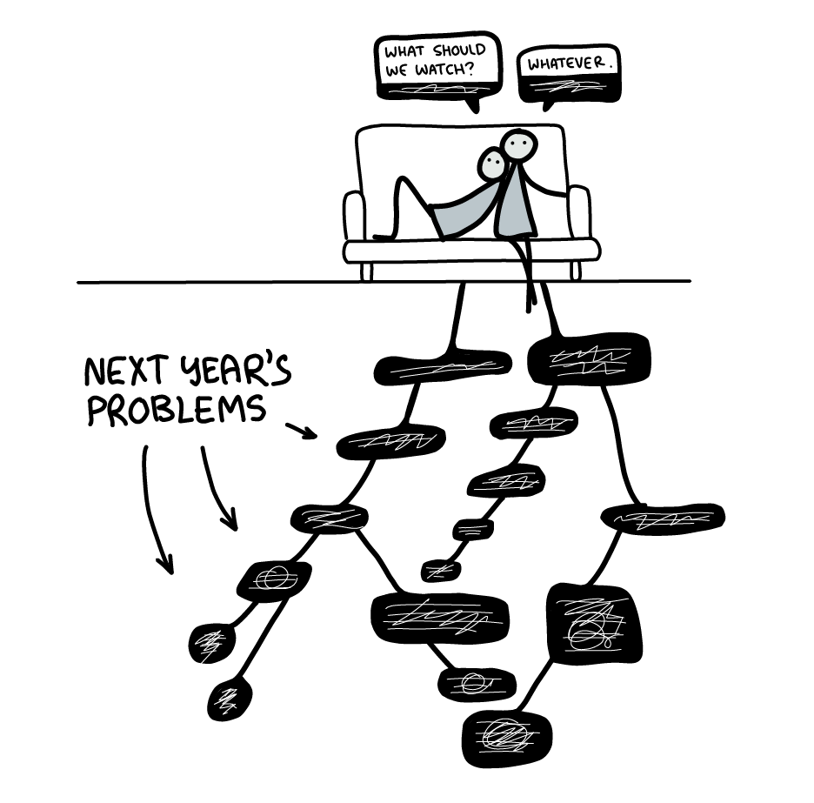
Misconception #3
Arguments end
Arguments have deep roots and will always find a way to grow back again.
In a relationship, we must cobble together compromises at regular intervals to help bridge the gap between our different tastes and preferences.
Notes:
Ruinous empathy

Slide 9
Realms of Anxiety The discernment of which is the first step to productive disagreement
Head
Heart
Hands
Anxiety about what is true
Information and Science
“What” of a situation.
Anxiety about what is meaningful
Preferences and Values
“Why” of a situation
Anxiety about what is useful
Practicality and Planning
“How” of a situation
Notes:
The worst arguments happen in light of bringing different anxieties to the conversation.
Starting with “What is this about?” can help us get on the same page

Slide 10
The Shadow Realm
Notes:
Sometimes we think we’re disagreeing with a person, but we’re really just arguing with a shadow projection of our own fears and imaginings.
The shadow will always live up to our worse fears and stereotypes.
Antidote: Argue with a real person in conversation with you, and then actually listen to their argument rather than putting words in their mouth.

Slide 11
Notes:
Being proficient at productive disagreement is like a superpower that levels up everything else in your life.

Slide 12
Eight Things to Try #1: Watch How Anxiety Sparks
Notes:
Anxiety which leads to disagreement comes when expectations and reality are mismatched.
Pay attention to the level of anxiety and what it’s about.

Slide 13
Watch How Anxiety Sparks
When expectations don’t meet reality ask:
How much anxiety am I feeling? (1-5 scale)
What is the source of my anxiety? (Is this about the Head, Heart or Hands?)
Discern(through questions and conversation) what all parties are experiencing in level and source of anxiety
Beware the lure of “Head” anxiety. It’s easiest to solve through expertise, but most deep conflict is more about “Heart” and/or “Hands.”

Slide 14
Eight Things to Try #2: Talk to Your Internal Voices

Slide 15
Talk to Your Internal Voices
The thoughts and feelings that flow from the spark of anxiety are only internal voices and do not necessarily have the final say on what we absolutely need to think or feel.
They exist to help us reduce our anxiety.

Slide 16
Talk to Your Internal Voices
The Voice of Power
“Might is right.” “Take it or leave it.” “My way or the highway.” “Do as I say.” “That’s an order!” “This isn’t a debate!” “Beggars can’t be choosers.” “Finders keepers, losers weepers.”
Force a resolution. Quickest resolution, but often with consequences.

Slide 17
Talk to Your Internal Voices
The Voice of Reason
“Why?” ”Show me the evidence.” “That doesn’t add up.” “What’s fair is fair.” “I didn’t make the rules.” “That’s not how it’s done.”
Shut down a debate through rationality. Often relies on external authority (law, religion, etc.)
Most useful for people in the same group, but often relies on Voice of Power for enforcement.

Slide 18
Talk to Your Internal Voices
The Voice of Avoidance
“The only winning move is not to play.” “I would prefer not to.” “Leave me out of it.”
Conflict avoidance. Doesn’t fix the problem, but acknowledges that Power and Reason are sometimes not enough.

Slide 19
Talk to Your Internal Voices Side Effects
Voice of Power
Voice of Reason
Voice of Avoidance
Creates resentment and polarization
Exiled opinions don’t disappear permanently
Seeks efficiency at the cost of well-rounded growth
Low-priority problems, often ignored, can pile up, merge, grow new limbs
Buys a short-term respite but doesn’t move the needle on conflict.
Notes:
All learned from context and culture. Have driven human interaction and decision making for millenia.

Slide 20
Talk to Your Internal Voices
The Voice of Possibility
“What are we missing?” “What else is possible?” “What else can we do with what we have?” “Who else can we bring into the conversation to give us a new perspective?”
Sees conflict not a a problem (like the first three), but something that can be productive. Explicitly pushes us to NOT do what the other voices would have.

